Slide 1
Student Accounts

Slide 2
Session Goals
Learn about the student account at Drake, authorized users, the access available to an authorized user and how a student sets up individuals for this role
Understand when bills are available and the methods of payment; explain how to use authorized financial aid to decide on payment plan amounts
Be aware of the guidelines for account payment and when registration holds may be placed

Slide 3
Our Offices
Monday - Friday, 8:00 a.m. - 4:30 p.m. www.drake.edu/accounts
Student Account Services
Cashier’s Office
Location: 103 Carnegie Hall
Contact Us: 515-271-4777 or stuacct@drake.edu
We are here to help you:
understand charges on your student account
understand available options regarding how to pay your bill
understand how to receive refund when payments are greater than your bill
Location: 104 Carnegie Hall
Contact Us: 515-271-3805
By stopping by the Cashier’s Office you are able to make payments on your university bill.

Slide 4
Ways to Pay
ONLINE
Students and Authorized Users can make e-check, debit card, and credit card payments online.
*2.95% service fee for credit card payments
MAIL
Mail check payments with student name and ID# to:
Drake University Cashier’s Office
104 Carnegie Hall
2507 University Avenue
Des Moines, IA 50311
IN-PERSON
We accept cash and check payments in person at the Cashier’s office.
COLLEGE SAVINGS PLAN
Work directly with your College Savings Plan to coordinate payment.
INTERNATIONAL WIRE TRANSFER
Click the TransferMate button within the online payment platform

Slide 5
Payment Options (option 1)
Payment in Full
Payment in full is due on or before the first day of classes each semester
1.5% monthly late fee charged on any remaining balance

Slide 6
Payment Options (option 2)
Installment Semester Payment Plans
Pay for each semester over a specific number of months
Fall Plan - due Sep 1st, Oct 1st, Nov 1st and Dec 1st.
Spring Plan - due Feb 1st, Mar 1st, Apr 1st, and May 1st.
Summer Plan- due June 1st and July 1st
Cost is $30 per semester to sign up.
$25 late fee (per installment) for missed installments
Must sign up by the 10th business day of each semester
Sign up by going to the Student Account section on the student page in myDrake and selecting “Make a Payment”, or login as an authorized user
Select the autopay option so the payment is automatically taken from the bank account of your choice each month

Slide 7
Fall Semester Billing Process
Fall semester bill notification emailed
First Day of the Semester!
Fall semester bill due
Final day to sign up for the monthly payment plan
Late fees and registration holds added to unpaid accounts and accounts not current on the payment plan
Monthly email reminders sent to students and authorized user(s) with unpaid bills
Available financial aid will apply to your bill
Early August
August 18th
August 28th
September 8th
September 8th
September 20th

Slide 8
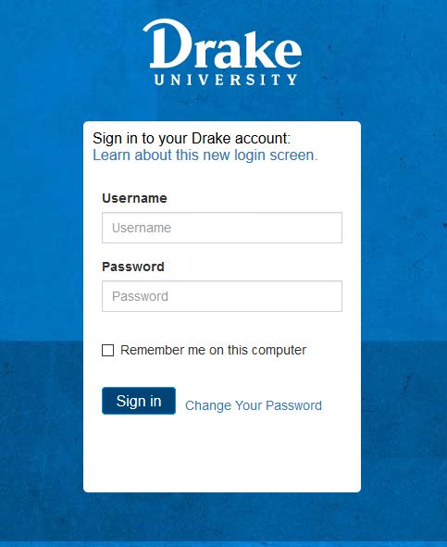
Adding an Authorized User (part 1)
Due to FERPA (Family Educational Rights and Privacy Act) regulations, financial information cannot be shared without the student’s permission.
By adding an authorized user to your account Student Accounts is able to share information if they call with questions
Authorized users can also view and make payments on your bill and view important tax documents.
You can add as many authorized users as you would like.
To begin the student needs to login to their myDrake account
Start here

Slide 9
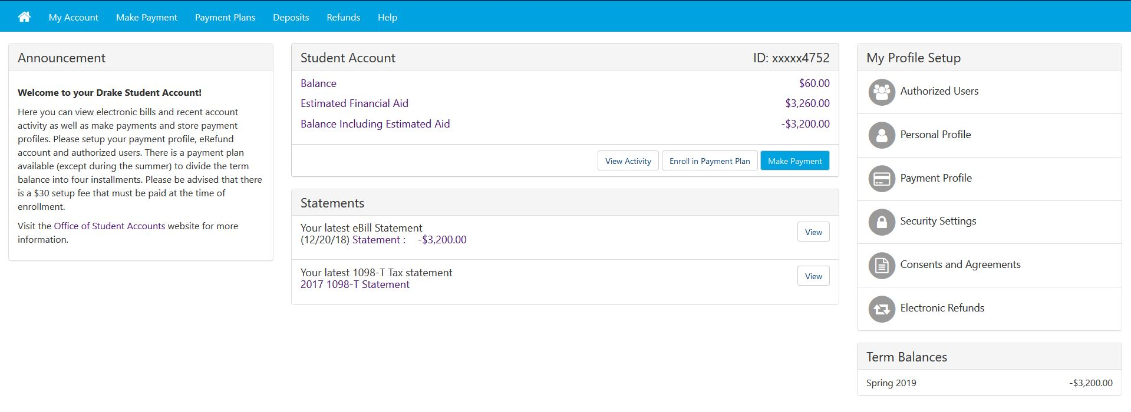
Adding an Authorized User (part 2)
1
3
2

Slide 10
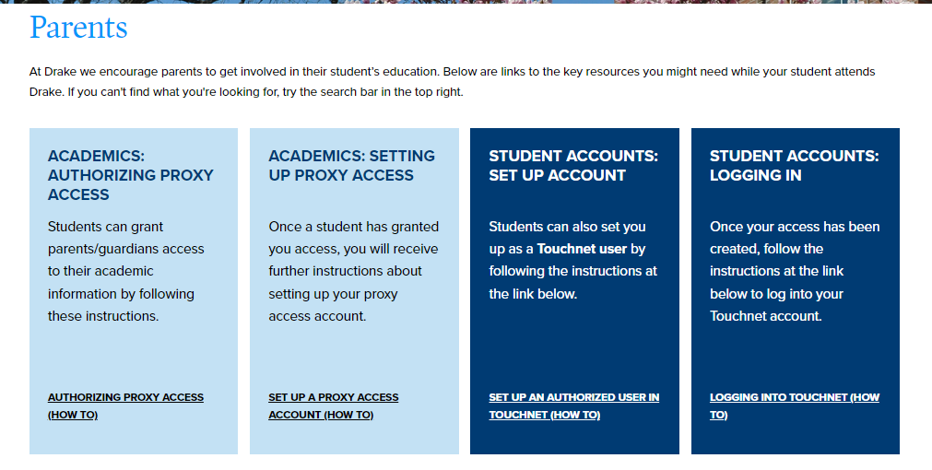
Authorized Users Account Access
http://www.drake.edu/parents Please Note: Parent proxy access (for academics) is SEPERATE from Authorized User log-in (for billing)!
Follow these steps!

Slide 11
Authorized User View After Initial Login

Slide 12
Setting up Direct Deposit for Refunds
This allows us to refund any money back to the student if financial aid or payments exceed the bill.
Only the student has access to set this up
We will never take money from this account, it is just for refund purposes but you can also select to make payment from it if you choose.
Login to myDrake
Go to “Student Account & Financial Aid”
Click “Make a Payment”
Click “Electronic Refunds”
Select “Set up a Refund Account”
Click “Continue” and follow the confirmation instructions
You can go back and update the account at anytime

Slide 13
Student Account Checklist…It’s as easy as 1,2,3!
Set up authorized users if you would like others to have access to billing and tax information
Set up direct deposit
Decide how you will pay any remaining balance, if you plan to use a payment plan sign up between August 1st and September 1st

Slide 14
Please contact us with any questions!
Student Accounts
Phone: 515-271-4777
E-mail : stuacct@drake.edu

